Slide 1
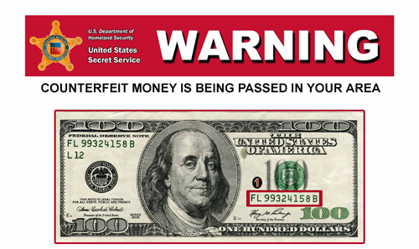

Detecting Counterfeit Banknotes Of Bangladesh

Slide 2

Supervised by
Dr. Md Zulfiker Mahmud
Associate Processor
CSE,JNU
02
2

Slide 3
Agenda
01
Introduction
05
02
Objective
06
03
Identify Original Note
07
04
Workflow for Fake Note Detection
08
05
Steps to Detect Fake Note
09
06
Techniques
10
07
Tools and Libraries
11
08
Project Demonstration
12
03

Slide 4


Team Fix_it
Tanvir Ahammed Hridoy
ID: B180305020
Susmita Rani Saha
B180305047
04

Slide 5
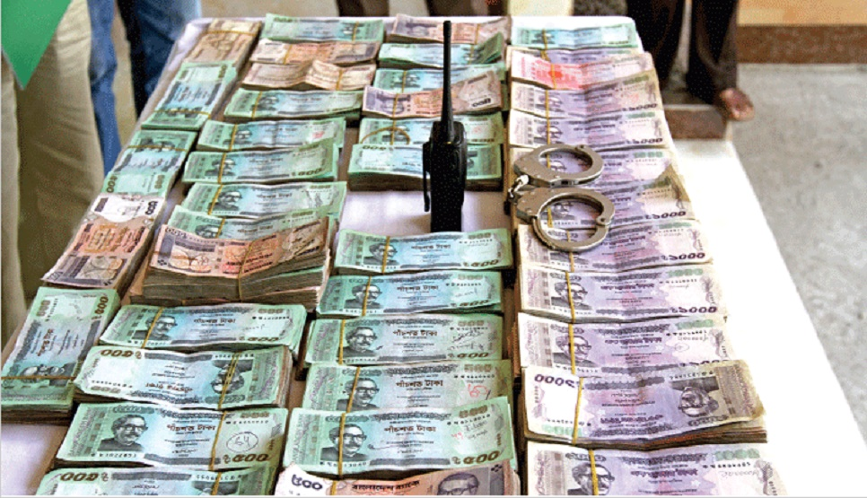
Introduction
Fake currency notes pose a significant threat to financial systems. Counterfeit banknotes and its impact on the economy.
Counterfeiting has far-reaching negative effects on various aspects of society, including the economy, consumer trust, public safety, and the rule of law.
Digital Image Processing (DIP) techniques can be employed to identify counterfeit banknotes.
05

Slide 6
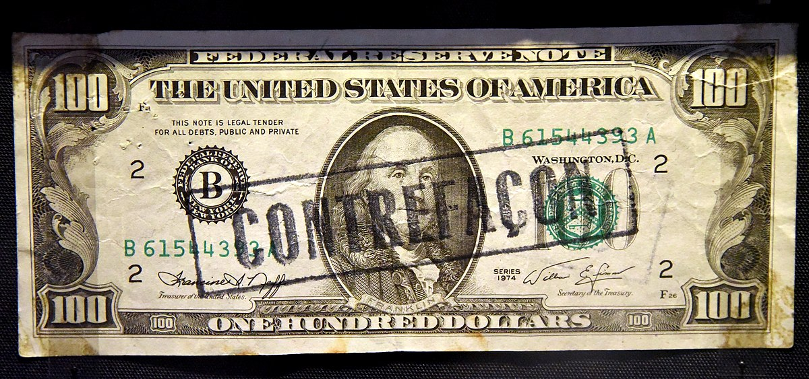
Objective
Increased Security: Safeguarding financial systems against counterfeit currency.
Automation: Fast and accurate detection without manual intervention.
Cost-Efficient: OpenCV is an open-source library, reducing the need for expensive proprietary software.
06

Slide 7
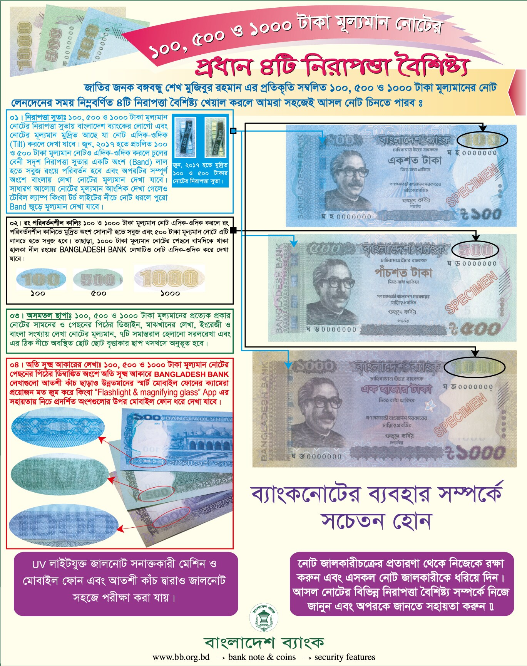
Identify Original Note
07

Slide 8
Workflow for Fake Note Detection
Scanning or capturing the image of the banknote.
Image enhancement techniques to improve the quality of the captured image.
Acquisition
Extracting relevant features from the pre-processed image.
Pre-processing
Use Pattern recognition algorithms to classify the note as genuine or fake
Feature Extraction
Classification
08

Slide 9
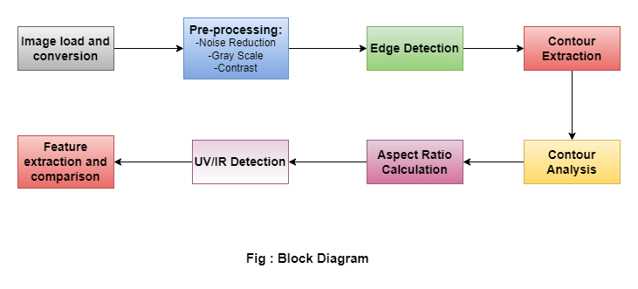
Steps to Detect Fake Note
09

Slide 10
Techniques in Fake Note Detection:
Contour Analysis: Contour Analysis can also be used in watermark detection and microprint analysis.
Watermark Detection: Watermarks are embedded security features in genuine banknotes that are often subtle and difficult to replicate. By analyzing the contours and regions of interest, contour detection can help identify the presence and location of watermarks.
Microprint Analysis: Microprint is a security feature consisting of tiny, intricate patterns that are difficult to replicate accurately. By extracting the contours of microprint regions, contour detection can assist in identifying and comparing the microprint patterns on the banknote, aiding in determining its authenticity.
UV/IR Detection: Verifying the presence of ultraviolet (UV) or infrared (IR) features on genuine notes.
10

Slide 11
Tools and Libraries
Tools:
PyCharm IDE
Libraries:
OpenCV :(Open Source Computer Vision Library) is a popular open-source library for computer vision and image processing tasks.
numpy : This is a popular library for numerical computations in Python. It provides support for multi-dimensional arrays and mathematical functions.
imutils: This is a package that provides convenience functions to simplify common image processing tasks, such as resizing, rotating, and contour operations.
11

Slide 12
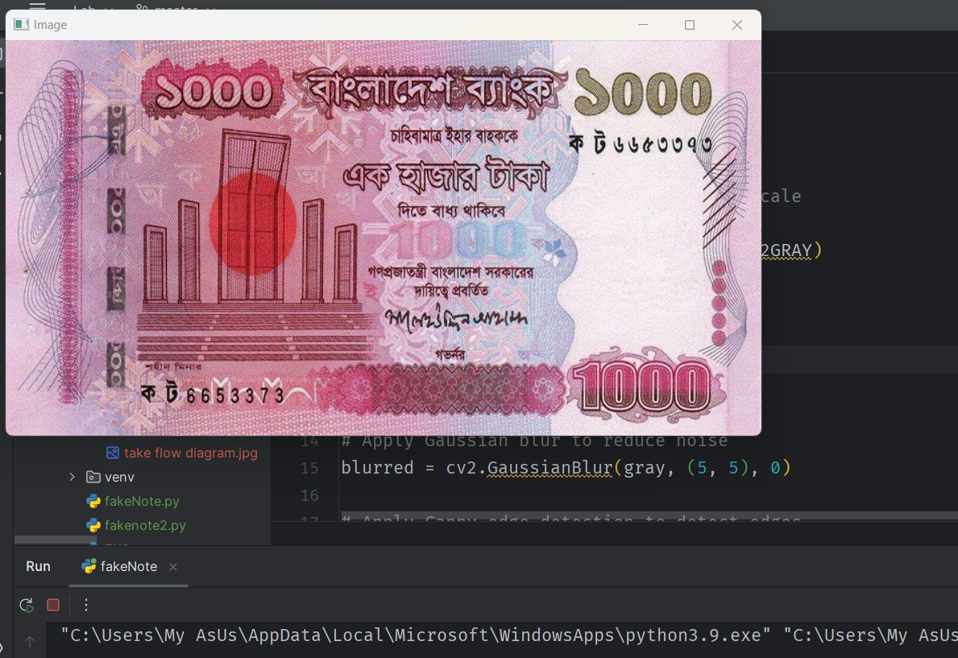
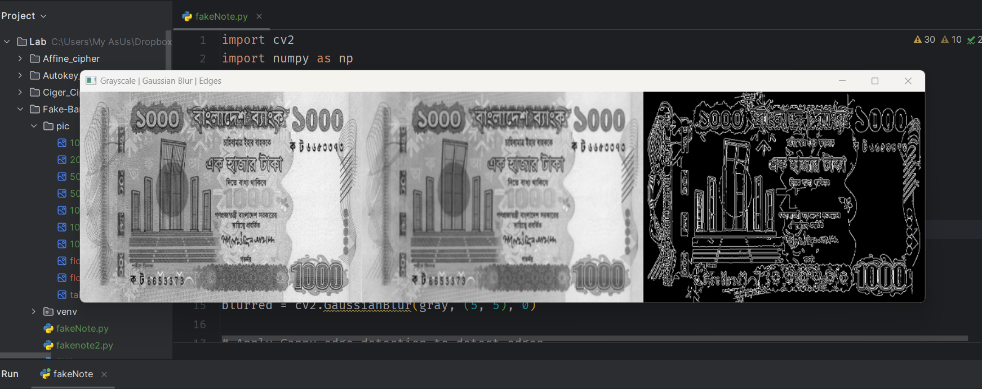
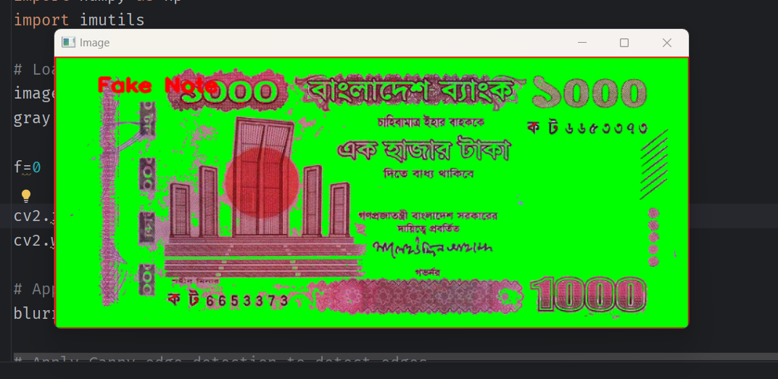
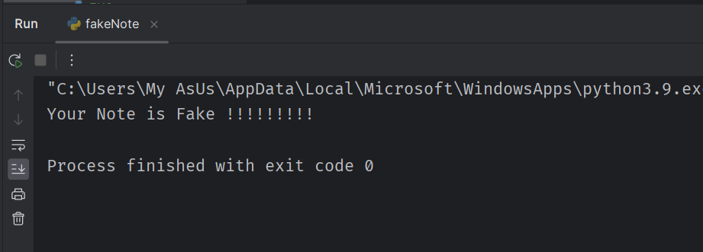
Project Demonstration
12

Slide 13
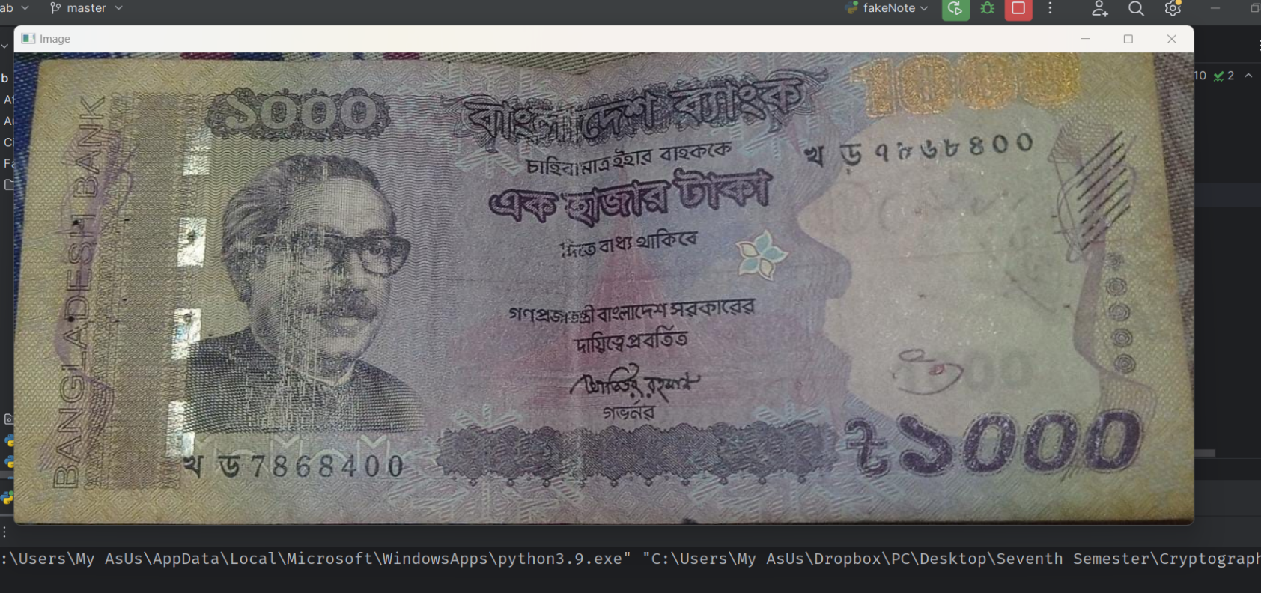
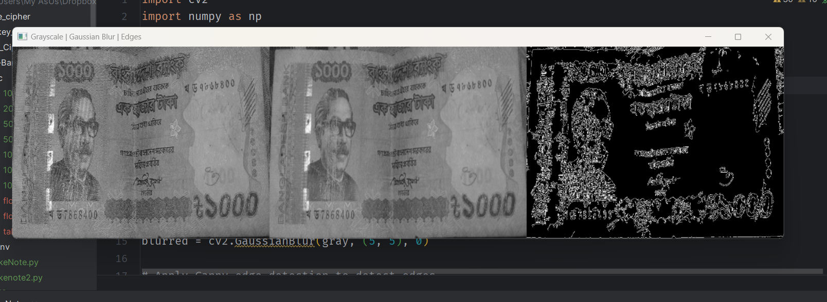
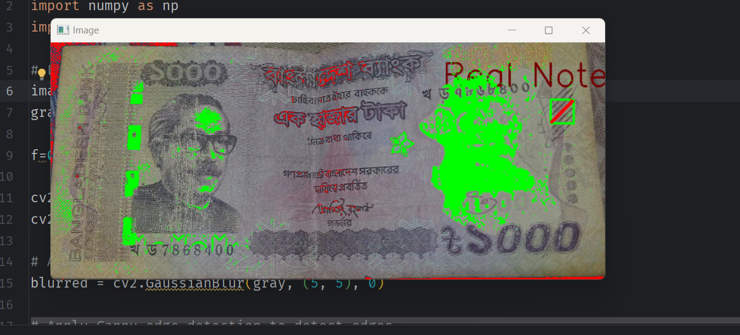
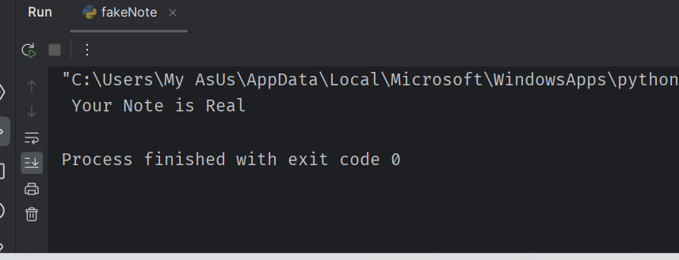
Project Demonstration
13

Slide 14
THANK YOU
Any Query?

